Slide 1

PHP
Conditional statements & Operators
@ Md. Mizanur Rahman

Slide 2

Conditional Statements
PHP allows us to write code that perform different actions based on the results of a logical conditions at run time. This means, we can create test conditions in the form of expressions that evaluates to either true or false and based on this result we can perform certain actions.
There are several statements in PHP that you can use to make decisions:
The if statement
The if...else statement
The if...elseif....else statement
The switch...case statement
01

Slide 3
if statement
The if statement is used to execute a block of code only if the specified condition evaluates to true. This is the simplest PHP's conditional statements.
<?php $num = 31;
if($num >= 20){
echo “Number is greater than 20”;
}
?>
if(condition){
// code to be executed
}
Structure of if statement
02

Slide 4
if-else statement
You can enhance the decision making process by providing an alternative choice through adding an else statement to the if statement
<?php $num = 31;
if($num <= 20){
echo “Number is less than 20”;
}
else{
echo “Number is greater than 20”;
}
?>
if(condition){
/* code to be executed
if condition is true*/
}
else{
/* code to be executed
if condition is false*/
}
Structure of if-else statement
03

Slide 5
if-elseif-else statement
The if...elseif...else a special statement that is used to combine multiple if...else statements.
if(condition1){
/* code to be executed if condition1 is true*/
}
else if(condition2){
/* code to be executed if condition1 is false & condition2 is false*/
}
else{
/* code to be executed if condition1 is & & condition2 both are false*/
}
Structure of if-elseif-else statement
04

Slide 6
<?php $marks = -2;
if($marks > 0){
echo “Positive.”;
}
else if($marks < 0){
echo “Negative.”;
}
else{
echo “Zero”;
}
?>
The following example will output “Negative“.
Because, the value of marks is -2. So, 1st condition ( marks > 0 ) is false. But the 2nd condition marks < 0 is true.
That’s why code between 2nd block will execute and print Negative as output.
05

Slide 7
Nested if statement
The nested if statement contains the if block inside another if block. The inner if statement executes only when specified condition in outer if statement is true.
<?php $num = 17;
if($num > 10){
if($num < 20){
echo “Number is between 10 and than 20”;
}
}
?>
if(condition1){
if(condition2){
/* code to be executed
if condition1 & condition2 both will true*/
}
}
Structure of nested statement
06

Slide 8
switch-case statement
The switch-case statement is an alternative to the if-elseif-else statement, which does almost the same thing.
The switch-case statement tests a variable against a series of values until it finds a match, and then executes the block of code corresponding to that match.
switch(n){
case label1:
// code to be executed if n=label1
break;
case label1:
// code to be executed if n=label1
break;
. . . .
. . . .
default:
// code to be executed if n is different from all labels
break;
}
Structure of switch-case statement
07

Slide 9
<?php
if ($i == 0) { echo "i equals 0"; }
elseif ($i == 1) { echo "i equals 1"; }
elseif ($i == 2) { echo "i equals 2"; }
?>
<?php switch ($i) { case 0: echo "i equals 0"; break; case 1: echo "i equals 1"; break; case 2: echo "i equals 2"; break; }
?>
Same condition design using if-else and switch statement
08

Slide 10
Operators
Operators are symbols that tell the PHP processor to perform certain actions. For example, the addition (+) symbol is an operator that tells PHP to add two variables or values, while the greater-than (>) symbol is an operator that tells PHP to compare two values.
There are lots of operators in PHP;
Arithmetic operators
Logical operators
Spaceship operators
Assignment operators
Unary operators
Array operators
Comparison operators
Ternary operators
String operators
09

Slide 11
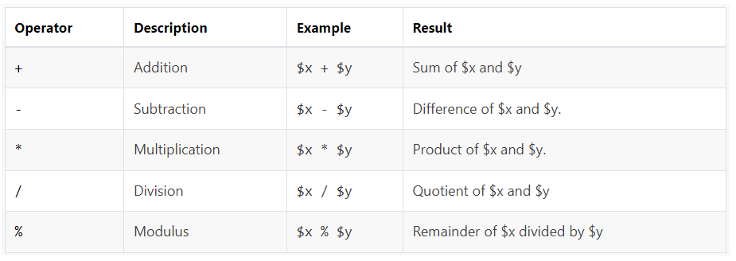
Arithmetic operators
The arithmetic operators are used to perform common arithmetical operations, such as addition, subtraction, multiplication etc.
10

Slide 12
The following example will show you these arithmetic operators in action:
<?php
$x = 10;
$y = 4;
echo($x + $y); // 0utputs: 14
echo($x - $y); // 0utputs: 6
echo($x * $y); // 0utputs: 40
echo($x / $y); // 0utputs: 2.5
echo($x % $y); // 0utputs: 2
?>
11

Slide 13
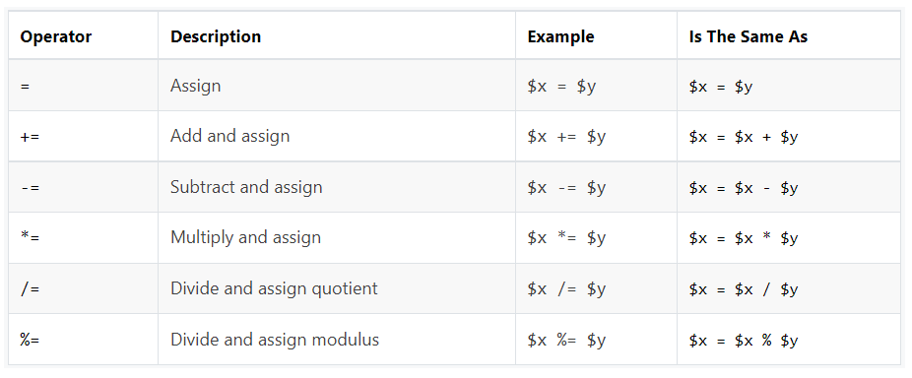
Assignment operators
The assignment operators are used to assign values to variables.
12

Slide 14
The following example will show you these assignment operators in action:
<?php
$x = 10;
echo $x; // Outputs: 10
$x = 20;
$x += 30;
echo $x; // Outputs: 50
$x = 50;
$x -= 20;
echo $x; // Outputs: 30
?>
13

Slide 15
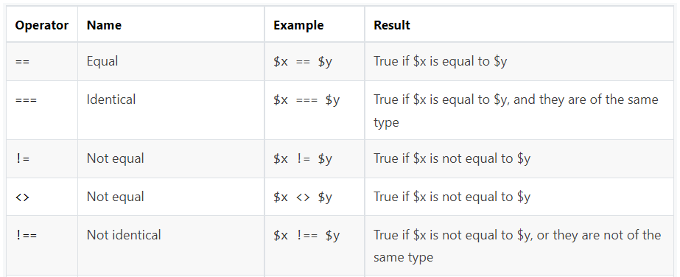
Comparison operators
The comparison operators are used to compare two values in a Boolean fashion.

Slide 16
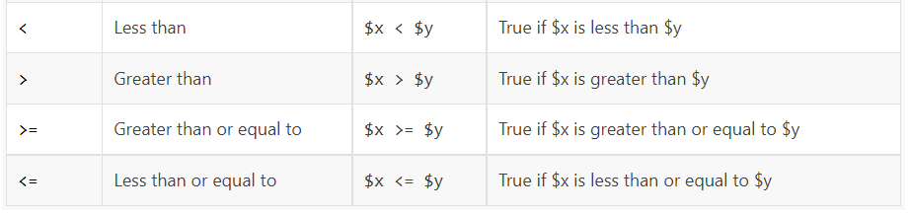
<?php
$x = 25;
$y = 35;
$z = "25";
var_dump($x == $z);

Slide 17
var_dump($x === $z); // Outputs: boolean false
var_dump($x != $y); // Outputs: boolean true
var_dump($x !== $z); // Outputs: boolean true
var_dump($x < $y); // Outputs: boolean true
var_dump ($x > $y); // Outputs: boolean false
var_dump($x <= $y); // Outputs: boolean true
var_dump($x >= $y); // Outputs: boolean false
?>

Slide 18
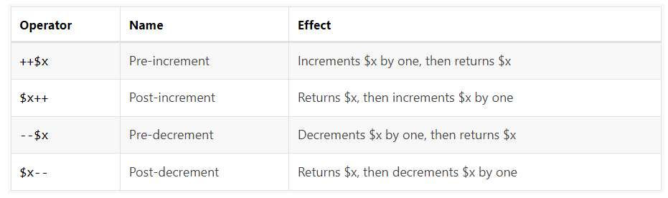
Unary operators
The increment/decrement operators are used to increment/decrement a variable's value

Slide 19
<?php
$x = 10;
echo ++$x; // Outputs: 11
echo $x; // Outputs: 11
$x = 10;
echo $x++; // Outputs: 10
echo $x; // Outputs: 11
$x = 10;
echo --$x; // Outputs: 9
echo $x; // Outputs: 9
$x = 10;
echo $x--; // Outputs: 10
echo $x; // Outputs: 9
?>

Slide 20
Ternary operators
The ternary operator is a conditional operator that decreases the length of code while performing comparisons and conditionals. This method is an alternative for using if-else and nested if-else statements.
(Condition) ? (Statement1) : (Statement2);
<?php
$mark = 40;
$z = "25";
echo ($marks>=40) ? “Pass" : “Fail"; // pass
?>

Slide 21
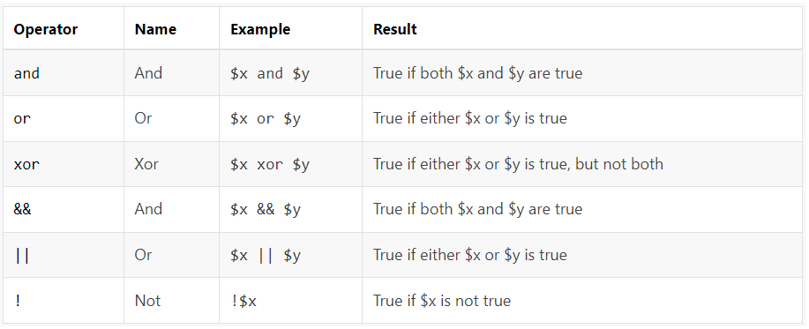
Logical operators
The logical operators are typically used to combine conditional statements.

Slide 22
<?php
$year = 2014;
// Leap years are divisible by 400 or by 4 but not 100
if(($year % 400 == 0) || (($year % 100 != 0) && ($year % 4 == 0))){ echo "$year is a leap year.";
}
else {
echo "$year is not a leap year.";
}
?>

Slide 23
THIS IS IT
THANK YOU

